Slide 1




Psychopathology and Synthesis
April 2024

Slide 2

DAY ONE

Slide 3

What we will cover
Day One
• Recap of CNG1 and CNG2 Psychopathology main poings
• Neurodiversity – Advanced topics and Case Studies
Day Two
• Mental Health – Advanced topics and Case Studies
• Trauma Strategies - Intro to EMDR
•

Slide 4

Recap: ‘Psychopathology and Assessments’ 1/3
Defence Mechanisms / Transference Counter-transference,
i.e., understanding of the use of transference and counter transference in assessing intra-personal and interpersonal dynamics.
Risk assessment
Session note writing
An understanding of mild to moderate psychological disturbances.
Personality disorders - narcissistic personality disorder, borderline personality disorder

Slide 5
Recap: ‘Psychopathology and Assessments’ 2/3
Assess client suitability for psychosynthesis counselling.
An ability to undertake a competent initial assessment and recognising factors that would contra-indicate client suitability.
Understanding the difference between on-line assessment and person to person assessment.
Increase reflective awareness with a focus on the impact of intersectionality and psychological assessment.
Taking risks in therapy. Even at the initial assessment.

Slide 6
Recap: ‘Psychopathology and Assessments’ 3/3
Defence Mechanisms / Transference Counter-transference,
i.e., understanding of the use of transference and counter transference in assessing intra-personal and interpersonal dynamics.
Risk assessment
Session note writing
An understanding of mild to moderate psychological disturbances.
Personality disorders - narcissistic personality disorder, borderline personality disorder

Slide 7
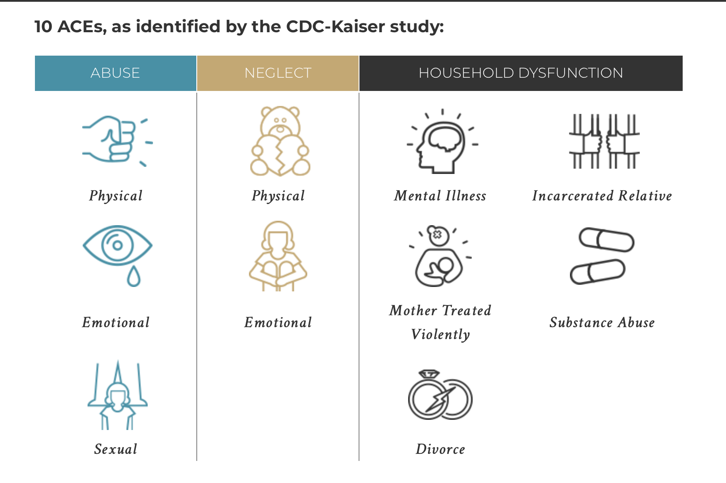

Slide 8
Specific Neurodiverse Topics
Sensory Processing Differences and Interventions
Executive Functioning Challenges and Support
Social Communication Nuances and Interventions
Co-occurring Mental Health Conditions in Neurodiversity
Trauma and Neurodiversity
Intersectionality and Neurodiversity

Slide 9

Recap: ‘Developmental Psychopathology’ 1/3
Examined the difference between spiritual emergence and spiritual emergency and psychosis.
Looked at the psychiatric categories of mental illness.
Discussed therapeutic strategies for working with selected disorders: depression, bipolar disorder, OCD, eating disorders.
Looked at the anti-psychiatry movement and positive mental health advocacy.

Slide 10

Recap: ‘Developmental Psychopathology’ 2/3
Discussed the meaning and purpose of assessing client suitability for psychosynthesis counselling.
Explored distinctions between spiritual emergence and spiritual emergency in psychosis.
Looked at our values about awareness of the importance of medication and limitations of counsellor input.
An ability to undertake a competent initial assessment and recognising factors that would contra-indicate client suitability.

Slide 11
Recap: ‘Developmental Psychopathology’ 3/3
Increase reflective awareness with a focus on the impact of intersectionality and psychological assessment
An understanding of mild to moderate psychological disturbances.
To describe your understanding of the terms and list at least two criteria
  Personality disorders –
  narcissistic personality disorder,
  borderline personality disorder
A brief discussion on neurodiversity issues.

Slide 12

ADHD vs AUTISM: Sensory Processing
Notes:
https://www.youtube.com/watch?v=y6-QMw08Whk

Slide 13
Sensory Processing DiFFERENCES (SPD) / ADHD
Notes:
https://www.youtube.com/watch?v=jl6UfPjRTJ8

Slide 14
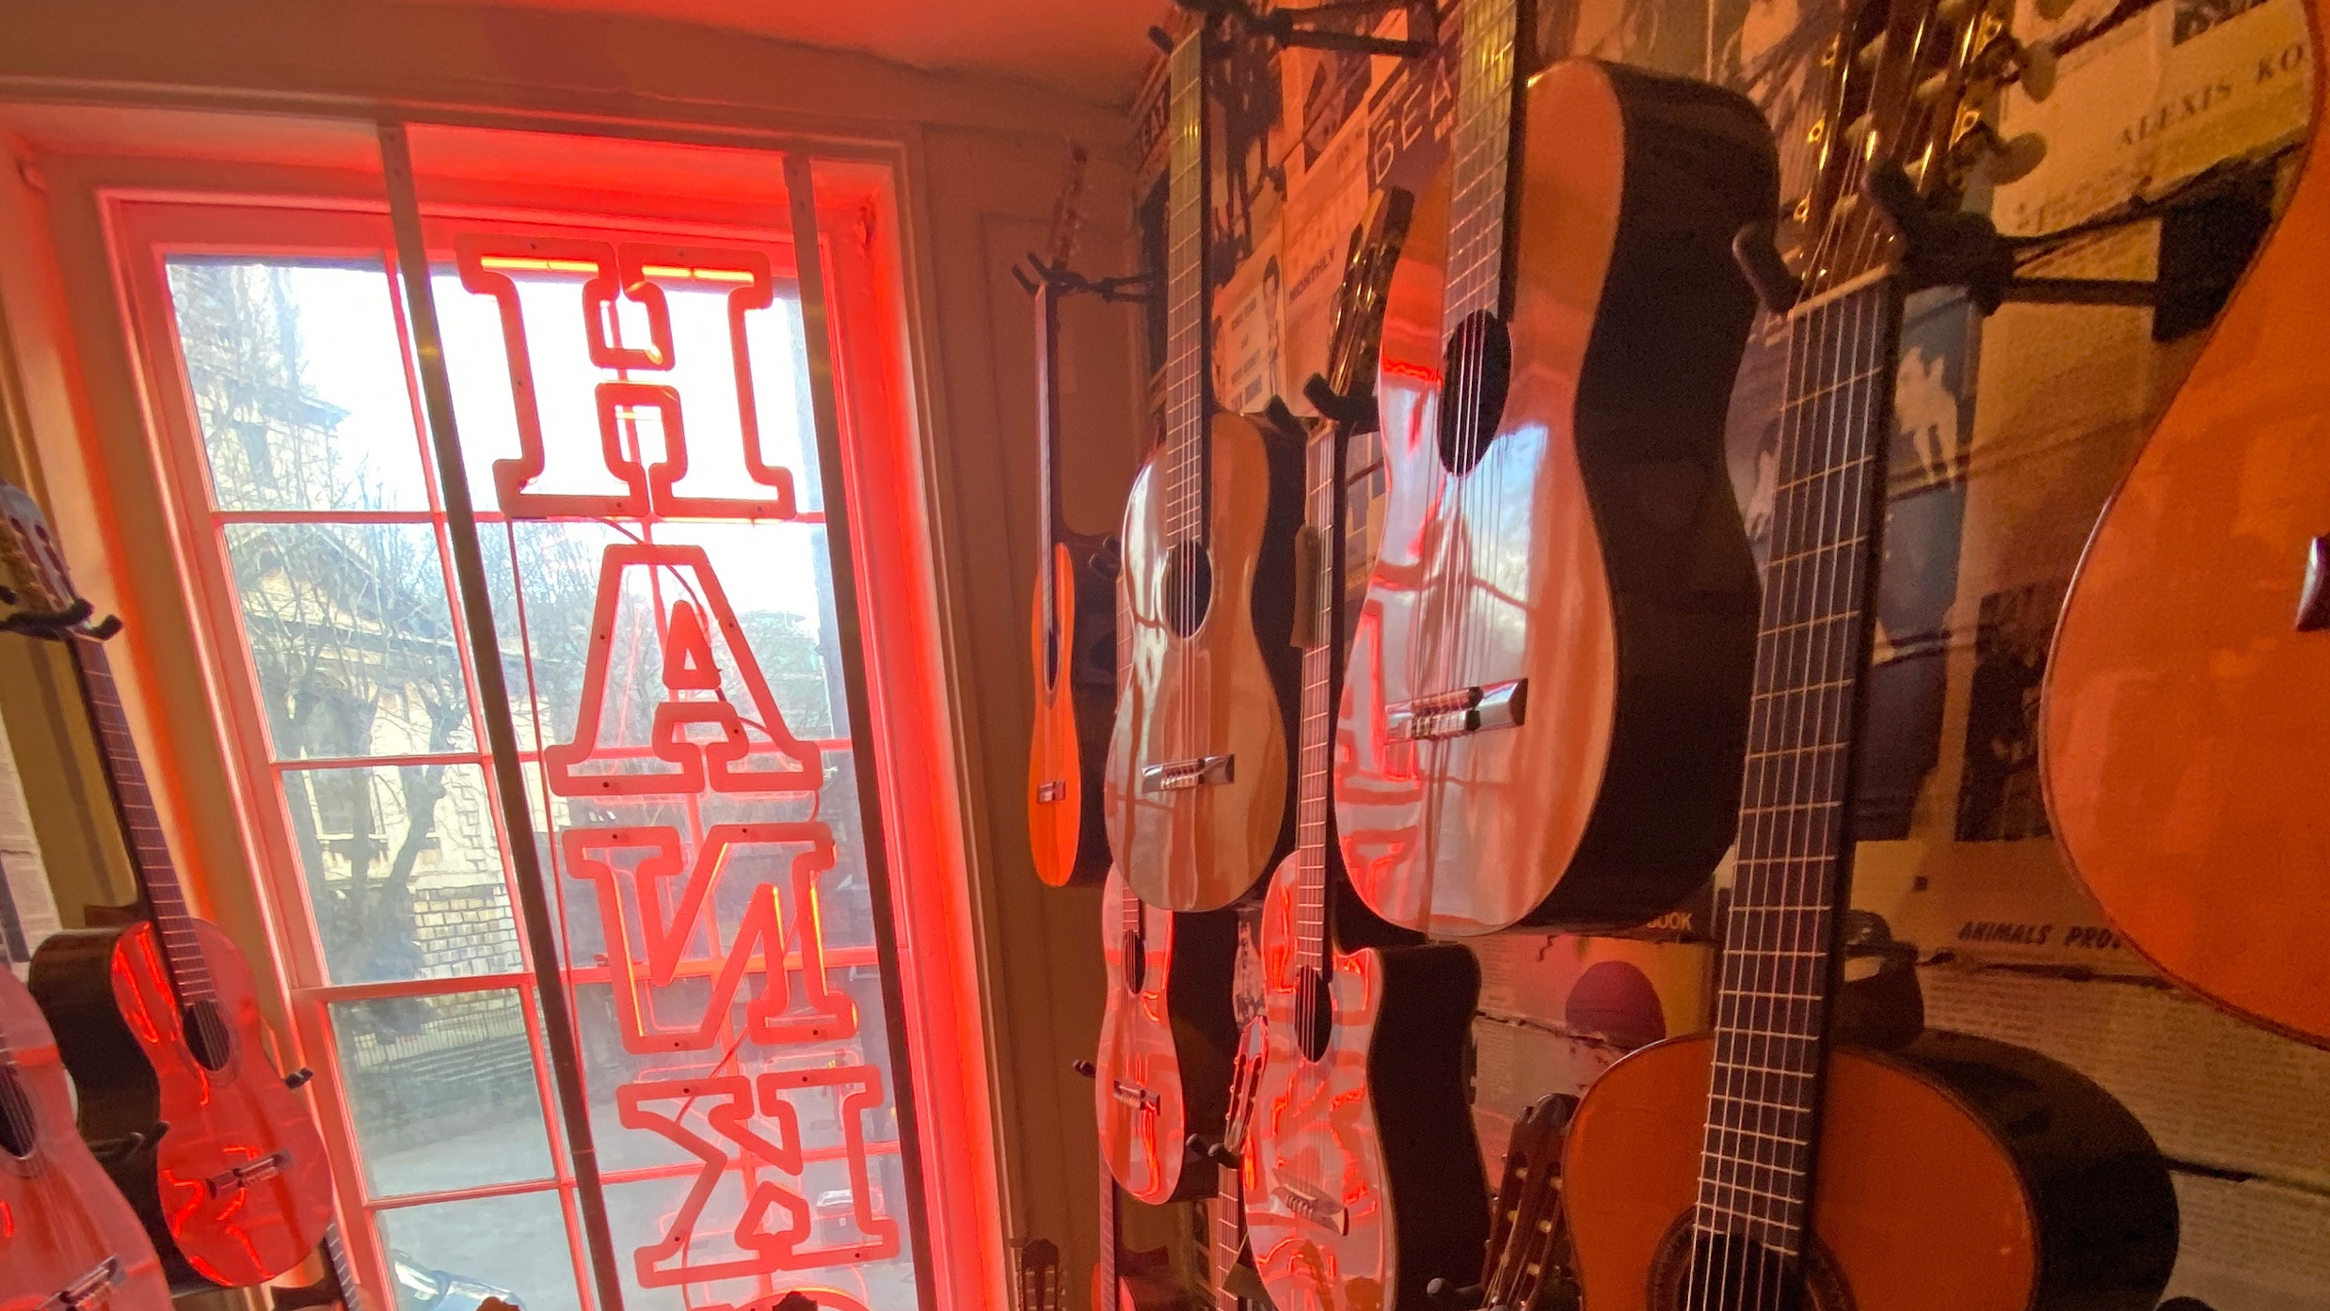
BREAK
(20 minutes)

Slide 15
What we will cover

Slide 18
DAY two

Slide 19

Topics: Mental Health Topics 1/ 2
Demystifying Mental Illness
Active Listening and Building Rapport
Ethical Considerations
Therapeutic Techniques
Culturally Competent Care
Self-Care for Therapists
Crisis Management
Supervision and Professional Development

Slide 20

Bipolar Disorder
(6:10)
Notes:
10 Signs of Bipolar Disorder:
https://www.youtube.com/watch?v=G_swth2iSFI&t=15s

Slide 22
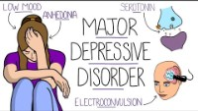
Depression Explained
Notes:
https://www.youtube.com/watch?v=tJQRsIbD110

Slide 23

SUICIDE PREVENTION

Slide 24
SUICIDE PREVENTION
The ASIST program = Applied Suicide Intervention Skills Training.
a two-day workshop designed to equip individuals intervene effectively when encountering someone at risk of suicide.
Currently referred to ASIST 11 the current version of the program,
Developed by LivingWorks Education Inc.
Not a substitute for proper mental health training. Supervision is essential when working with suicideal clients.
Notes:
LivingWorks ASIST - LivingWorks

Slide 25
Key Aspects of ASIST
Focus: Teaches participants how to connect, understand, and assist people with suicidal thoughts or plans.
Delivery: Conducted through a structured workshop format with interactive exercises and role-playing scenarios.
Impact: Trained individuals become more confident and equipped to provide initial support and prevent suicide tragedies.
Global Reach: The program has been delivered to over one million people in over twenty countries.

Slide 26
Key Aspects of ASIST
Focus: Teaches participants how to connect, understand, and assist people with suicidal thoughts or plans.
Delivery: Conducted through a structured workshop format with interactive exercises and role-playing scenarios.
Impact: Trained individuals become more confident and equipped to provide initial support and prevent suicide tragedies.
Global Reach: The program has been delivered to over one million people in over twenty countries.

Slide 27
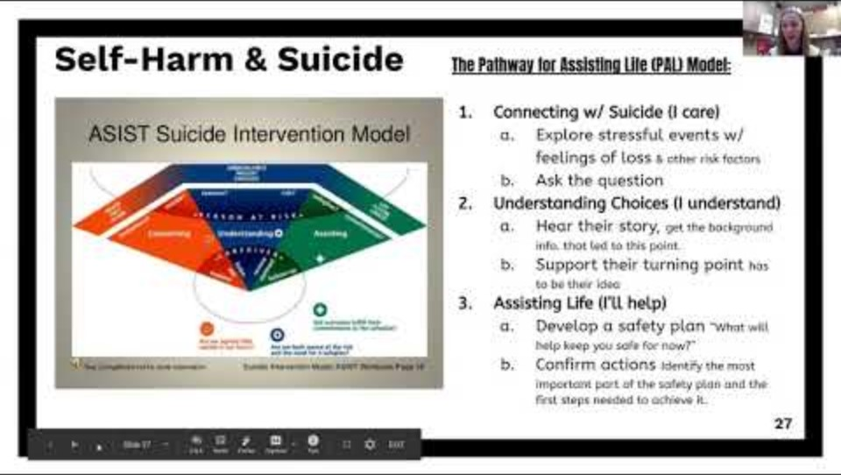
SUICIDE PREVENTION VIDEO
Notes:
(220) Faculty Suicide/Self-Harm debrief 1/13/20 - YouTube

Slide 28
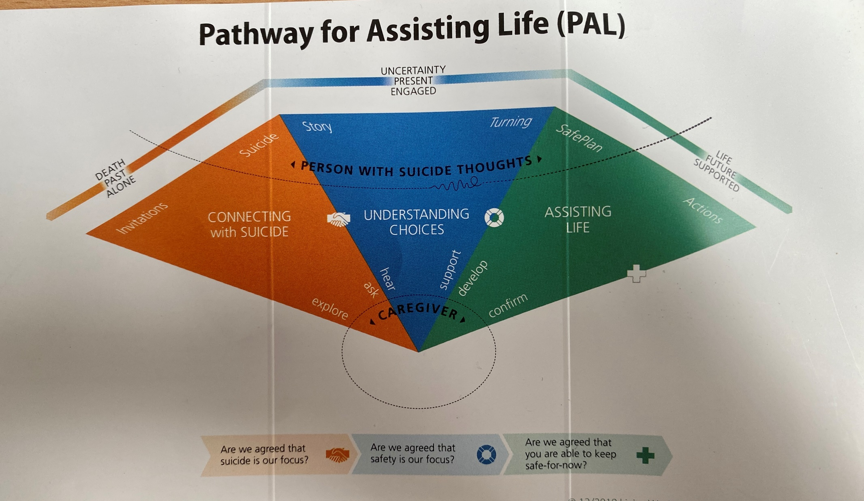

Slide 29
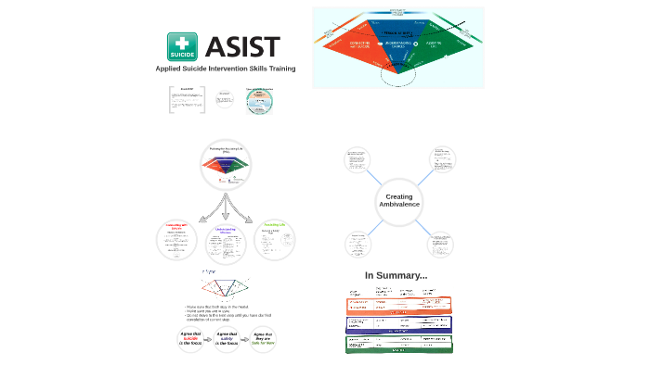

Slide 30
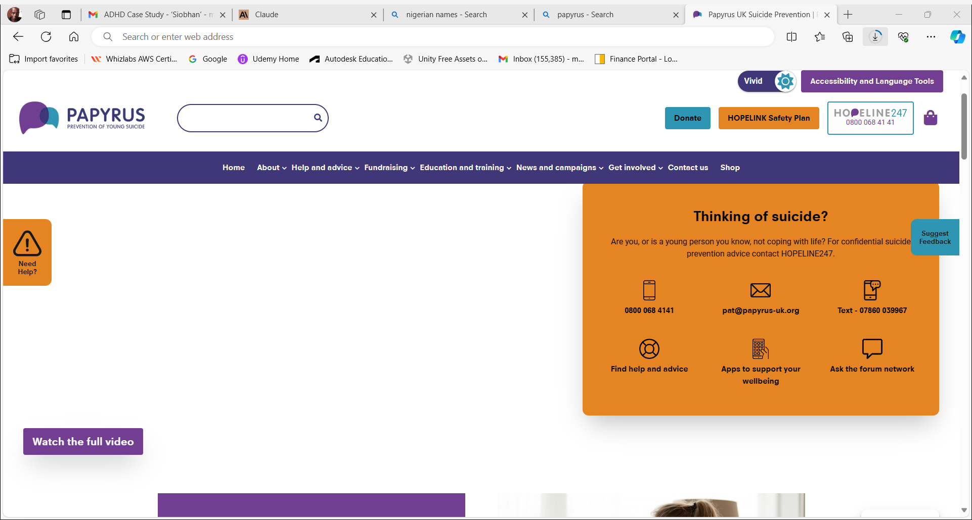
Papyrus.org.uk
Young Suicide
Prevention

Slide 31
BREAK
(20 minutes)

